Slide 1


CHINESE POSTMAN PROBLEM

Slide 2
LEARNING OBJECTIVES
Analyze the Chinese Postman problem
Apply an algorithm to solve the problem

Slide 3
INTRODUCTION
In 1962, a Chinese mathematician, Kuan Mei-Ko decided to determine the route of a postman, delivering mail to a number of streets, such that the total distance walked by the postman was as short as possible.
How could the postman ensure that the total distance walked was minimum?

Slide 4
SAMPLE PROBLEM
A postman has to start at A, walk along all 13 streets and return to A.
The numbers on each edge represent the length in meters of each street.
The problem is to find a trail that uses all the edges of a graph with minimum length.

Slide 5
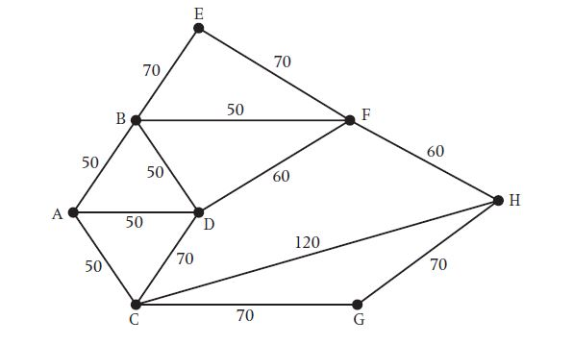
To Find A Trail That Uses All The Edges Of A Graph With Minimum Length.

Slide 6
Traversable graphs
A traversable graph is one that can be drawn without taking a pen from the paper and without retracing the same edge.
In such a case the graph is said to have an Eulerian trail.

Slide 7
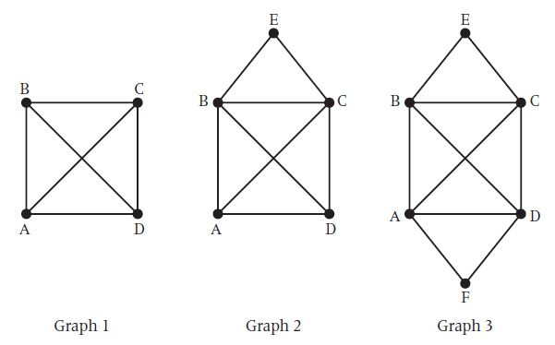
Some Traversable Graphs

Slide 8
Some Traversable Graphs (cont’d)
Graph 1, is impossible to draw without either taking the pen off the paper or re-tracing an edge
Graph 2, can be drawn only by starting at either A or D. In each case, the path will end at the other vertex of D or A
Graph 3, can be drawn regardless of the starting position and you will always return to the start vertex.

Slide 9
What Is The Difference Between the Three Graphs?
Graph 1 |  | Graph 2 |  | Graph 3
Vertex | Order | Vertex | Order | Vertex | Order
A | 3 | A | 3 | A | 4
B | 3 | B | 4 | B | 4
C | 3 | C | 4 | C | 4
D | 3 | D | 3 | D | 2
 |  | E | 2 | E | 2
 |  |  |  | F | 2

Slide 10
TRAVERSABLE GRAPHS
To draw the graph with odd vertices, edges need to be repeated.
To find such a trail we have to make the order of each vertex even.
In graph 1, there are four vertices of odd order and we need to pair the vertices together by adding an extra edge to make the order of each vertex four. We can join AB and CD, or AC and BD, or AD and BC.

Slide 11
TRAVERSABLE GRAPHS
An Eulerian trail uses all the edges of a graph. In a Eulerian graph, all the vertices must be of even order
If a graph has two odd vertices then the graph is said to be semi-Eulerian. A trail can be drawn starting at one of the odd vertices and finishing at the other odd vertex.

Slide 12
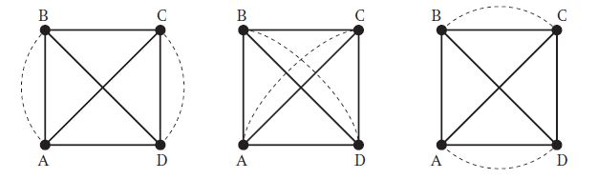
TRAVERSABLE GRAPHS
In each case the graph is now traversable

Slide 13
PAIRING ODD VERTICES
If there are two odd vertices, there is only one way of pairing them together.
If there are four odd vertices, there are three ways of pairing them together.
How many ways are there of pairing six or more odd vertices together?
If there are six odd vertices ABCDEF, then consider the vertex A.
It can be paired with any of the other five vertices and still leave four odd vertices. We know that the four odd vertices can be paired in three ways, therefore the number of ways of pairing six odd vertices is 5×3×1 = 15.

Slide 14
PAIRING ODD VERTICES (cont’d)
Similarly, if there are eight odd vertices ABCDEFGH, then consider the first odd vertex A. This could be paired with any of the remaining seven vertices and still leave six odd vertices.
We know that the six odd vertices can be paired in 15 ways therefore the number of ways of pairing eight odd vertices is 7×5×3×1 = 105 ways.

Slide 15
PAIRING ODD VERTICES
Number of odd vertices | Number of possible pairings
2 | 1
4 | 3×1 = 3
6 | 5×3×1 =15
8 | 7×5×3×1 = 105
10 | 9×7×5×3×1 = 945
n | (n1) ×(n3) ×(n5) …×1

Slide 16
CHINESE POSTMAN ALGORITHM
To find a route with the minimum distance for the Chinese Postman:
we must walk along each edge at least once
we must also walk along the least pairings of odd vertices on one extra occasion.

Slide 17
CHINESE POSTMAN ALGORITHM
Step 1 List all odd vertices.
Step 2 List all possible pairings of odd vertices.
Step 3 For each pairing find the edges that connect the vertices with the minimum weight.
Step 4 Find the pairings such that the sum of the weights is minimized.
Step 5 On the original graph add the edges that have been found in Step 4.
Step 6 The length of an optimal Chinese postman route is the sum of all the edges added to the total found in Step 4.
Step 7 A route corresponding to this minimum weight can then be easily found.

Slide 18
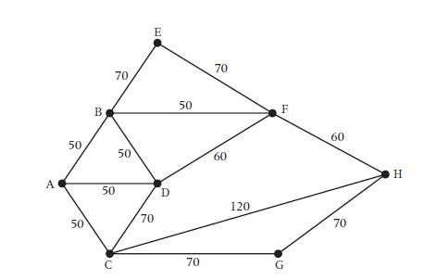
WORKED EXAMPLE

Slide 19
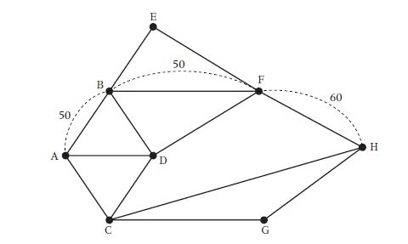
WORKED EXAMPLE

Slide 20
WORKED EXAMPLE
Step 1 The odd vertices are A and H.
Step 2 There is only one way of pairing these odd vertices namely AH.
Step 3 The shortest way of joining A to H is using the path AB, BF, FH, a total length of 160.
Step 4 Draw these edges onto the original network.
Step 5 The length of the optimal Chinese postman route is the sum of all the edges in the original network which is 840 m, plus the answer found in Step 4 which is 160 m. Hence, the length of the optimal Chinese postman route is 1000 m.
Step 6 One possible route corresponding to this length is ADCGHCABDFBEFHFBA, but many other possible routes of the same minimum length can be found.

Slide 21
FINDING A ROUTE
The method for finding the length of the Chinese postman route is quite straightforward, but to find the list of edges corresponding to this route can be quite tricky, especially in complicated networks. It is useful to calculate how many times each vertex will appear in a Chinese postman route. Therefore,The following method should be applied before trying to find the route.

Slide 22
FINDING A ROUTE
Step 1 On the original diagram add the extra edges to make the graph Eulerian.
Step 2 List the order of each vertex. At this stage each vertex will have an even order.
Step 3 The number of times each edge will appear in a Chinese postman route will be half the order of its vertex, with the exception being vertex A (the start/finish vertex), as this will appear on one extra occasion.

Slide 23
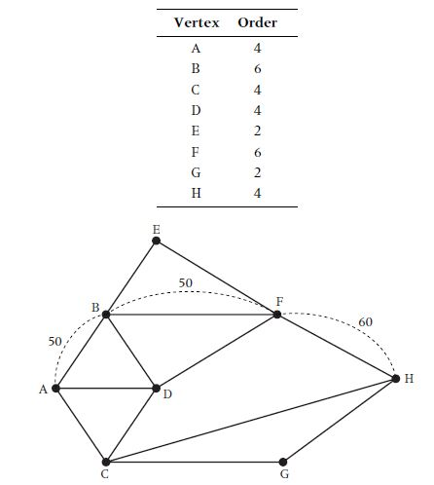
FINDING A ROUTE

Slide 24
FINDING A ROUTE
Vertices | Possible Pairings
A | 4÷2 = 2 = 2+1 =3
B | 6÷2 = 3
C | 4÷2 = 2
D | 4÷2 = 2
E | 2÷2 = 1
F | 6÷2 = 3
G | 2÷2 = 1
H | 4÷2 = 2
The number of vertices in the optimal Chinese postman route is 17.

Slide 25
VARIATIONS OF THE CHINESE POSTMAN PROBLEM
Occasionally problems may be set where the start vertex and the finish vertex do not have to be the same. Any graph with two odd vertices is semi-Eulerian.
For this type of graph the length of the Chinese postman route is the sum of all the edges of a network. In a network with four vertices, the graph is semi-Eulerian plus two odd edges. In addition to the start and finish vertices there are two other odd vertices.
The shortest Chinese postman route is the sum of all the edges plus the shortest distance connecting the two remaining odd vertices.

Slide 26
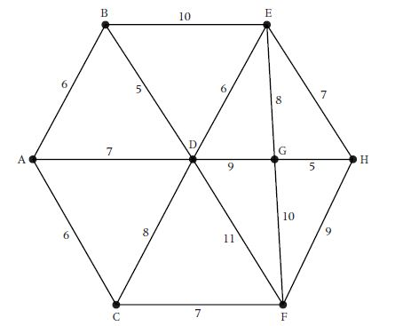
WORKED EXAMPLE

Slide 27
WORKED EXAMPLE
A county council is responsible for maintaining the following network of roads. The number on each edge is the length of the road in miles.
Solution
(a) There are four odd vertices: A, B, C and H.
There are three ways of pairing these odd vertices and the minimum length of each pairing is:
1. AB +CH = 6 +16 =22
2. AC+ BH =6+ 17 = 23
3. AH +BC = 21 + 12 = 33
Draw the edges AB and CH onto the network.
The length of all the roads in the network is 116.
Therefore, the length of an optimal Chinese postman route for the worker is 116 +22 = 138 miles.

Slide 28
THE END

